Slide 1

Topic : Farmers Market
Tools used : MySQL Workbench
Description :
This project focuses on applying SQL techniques to analyze customer, purchase, and vendor data across multiple datasets. It includes queries that filter customer names, categorize purchase amounts using CASE statements, summarize vendor–product relationships, and apply aggregations through GROUP BY and ORDER BY. The project demonstrates the ability to transform raw data into meaningful insights using core SQL operations.

Slide 2

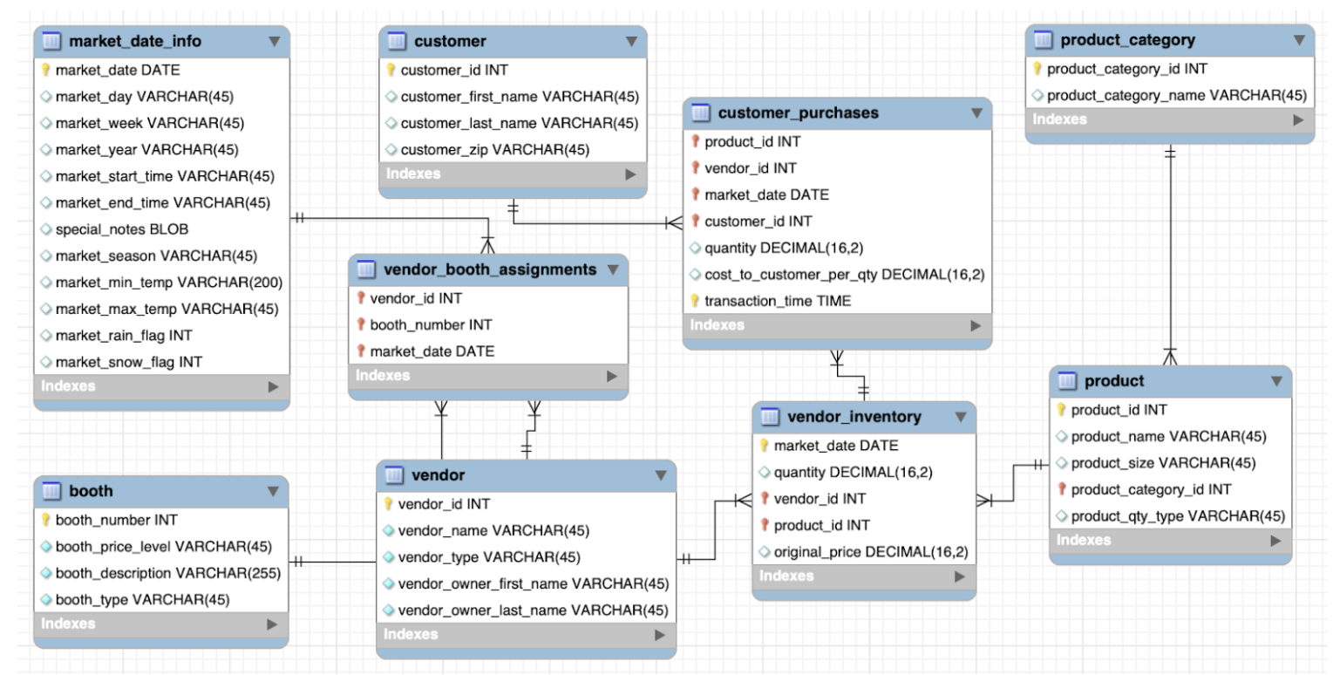
Database Schema

Slide 3








Slide 4



Slide 5
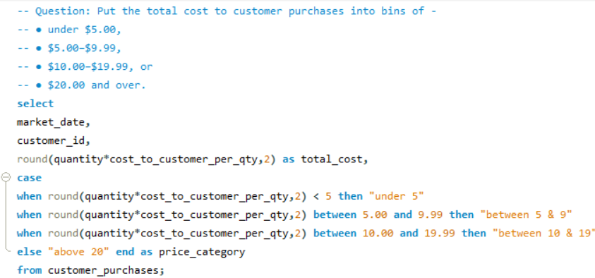
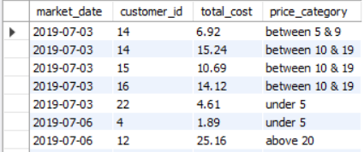

Slide 6



Slide 7



Slide 8








Slide 9



Slide 10
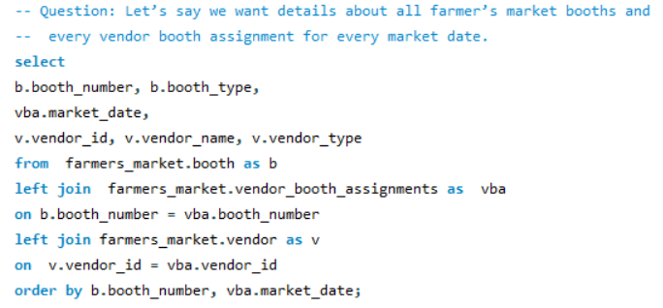


Slide 11



Slide 12

